Slide 1
Homies MarketPlace
Flávia Figueiredo [88887]
Pedro Marques [89069]
José Frias [89206]
Tomás Batista [89296]
Notes:
Tomás

Slide 2
Context
Homies MarketPlace allows:
Rent places
Search by places with specific requirements
Review places
Add places to the platform (owner perspective)
Add places to favorites
Notes:
Tomás

Slide 3
Agile project management practices & tools
Pivotal Tracker - to define the user stories
Trello - assignment of work between the group
Github flow - each user story will correspond to a branch in github)
Slack - channels divided by topic (frontend, backend, and so on)
Notes:
Flávia

Slide 4
Definition of Done
Unit and Integration tests pass
Quality gates defined in Sonarcloud are verified
Endpoint in the API (if necessary) is well defined
Meets the Acceptance Criteria defined in Pivotal Tracker
Notes:
José

Slide 5
Quality Gates in Sonarcloud
A at Maintainability, Security and Reliability
At least 80% of Test Coverage
Maximum of 5% in duplicated blocks
Notes:
José

Slide 6
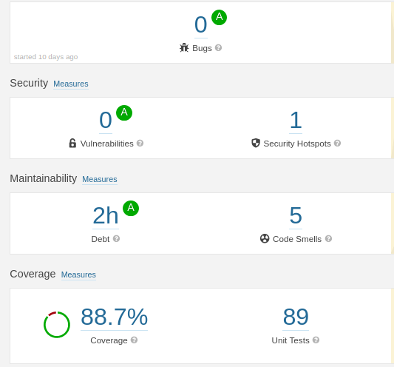
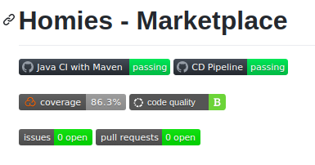
Sonarcloud Dashboard
Notes:
José

Slide 7
CI pipeline
Git actions
  On push to master
  On pull request to master
Builds, tests and verifies code
Sonarcloud check
Pushes code to repository if successful
Notes:
Pedro

Slide 8
CD pipeline
Git action
  on push to master
  on pull request to master
Self hosted runner
  Virtual Machine pulls directly from Github repository
Docker-compose
  Postgres DB and Webapp setup
Notes:
Pedro

Slide 9
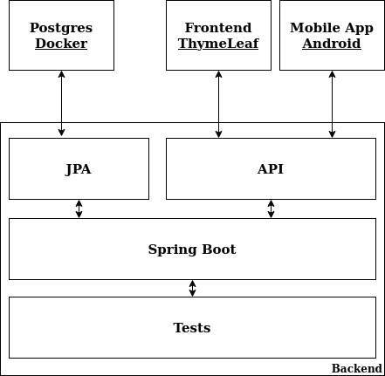
Product Architecture
Notes:
Tomás

Slide 10
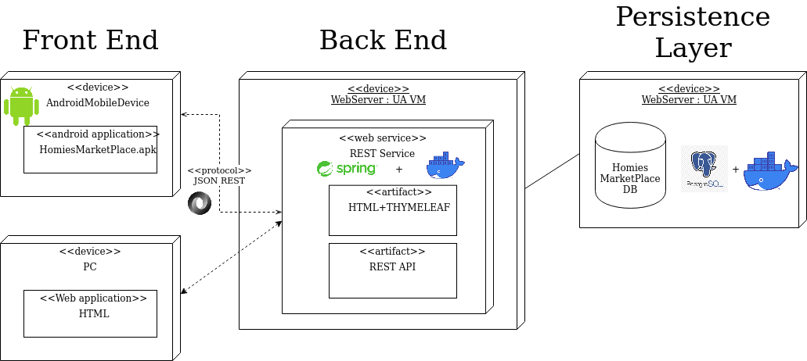
Deployment Diagram
Notes:
Tomás

Slide 11
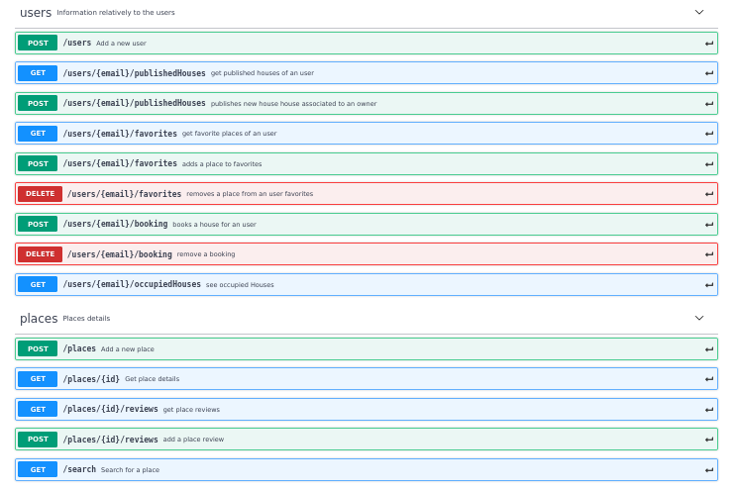
API
Notes:
José

Slide 12
Web Interface Demo
Notes:
Flávia

Slide 13
Android Demo
Notes:
José

Slide 14
RaspberryPi Demo
Notes:
Tomás

